Slide 1

iVR Integrated Vision and Radio Localization with Zero Human Effort
Jingao Xu*, Hengjie Chen*, Kun Qian†, Erqun Dong*, Min Sun*
Chenshu Wu‡, Zheng Yang*
*School of Software and BNRist, Tsinghua University
† University of California, San Diego
‡ University of Maryland, College Park
September 12, London, UK
Notes:
[START]Thank you for the introduction, and hello everyone
Today I’m going to talk about our work
iVR:integrated vision and radio localization with zero human effort

Slide 2
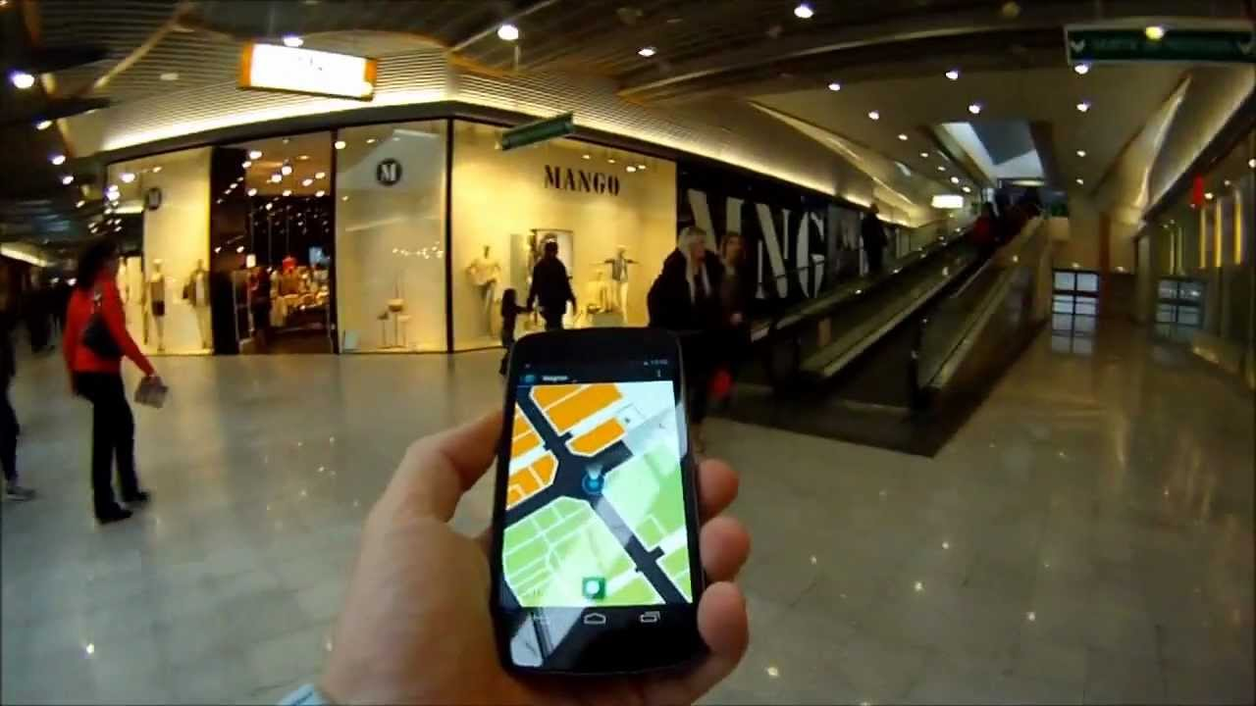
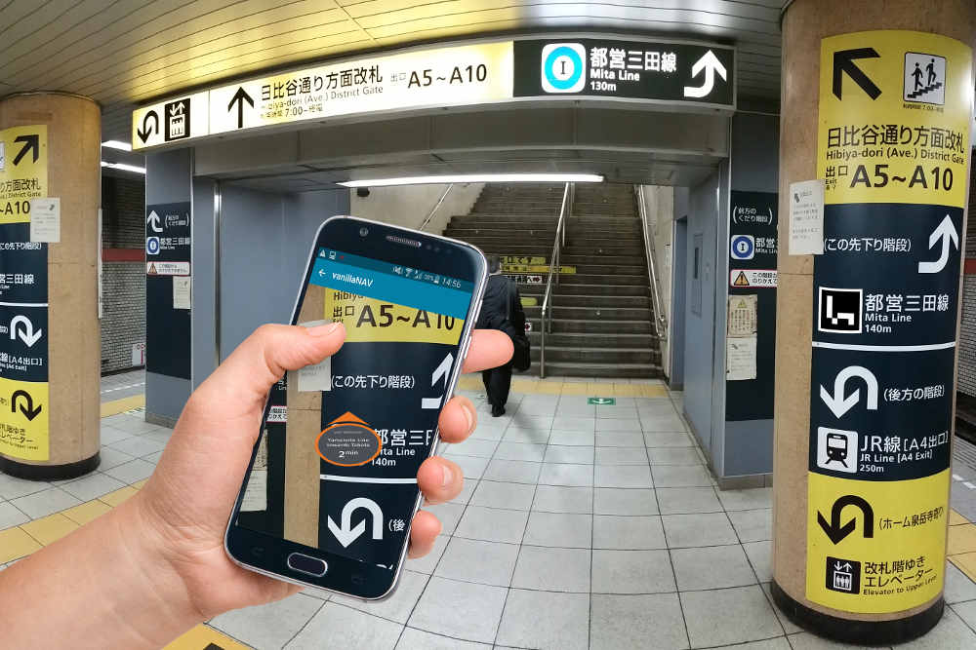
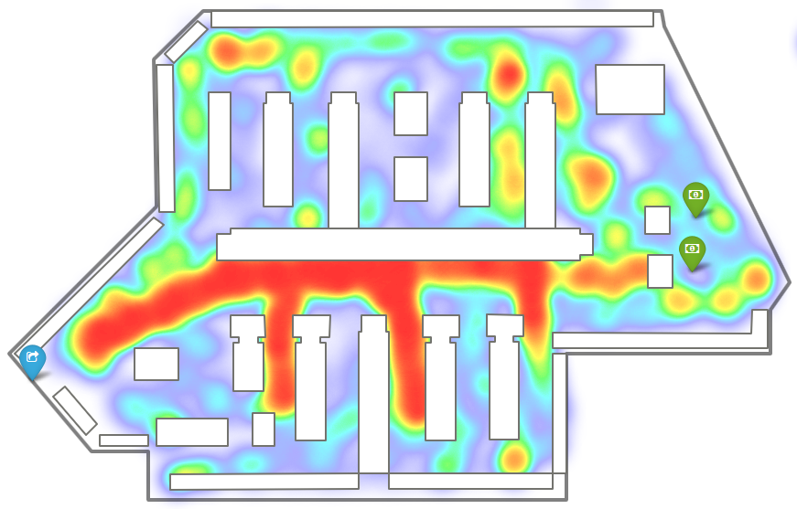
Motivation
Various location-based ubiquitous applications.
Locating or tracking with Wi-Fi & IMU
Ubiquitous: Almost everywhere installed infrastructure.
Low-cost: Off-the-shelf Wi-Fi devices and Inertial Measurement Unit.
Non-invasive: not required to wear/carry any special devices.
Suffer from both large location errors and considerable deployment costs.
Indoor Location
Navigation
PoI discovery
Notes:
[START]The proliferation of various location-based ubiquitous applications fosters the demand for accurate localization services.
[CLICK]Among various approaches, WiFi fingerprint-based localization and IMU based tracking has become the most attractive solutions due to these devices are ubiquitous and cheap
However, these methods are suffer from both large location errors and considerable deployment costs like site-survey and generate the floorplan

Slide 3
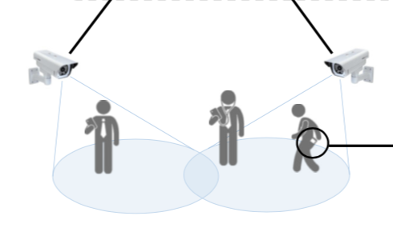
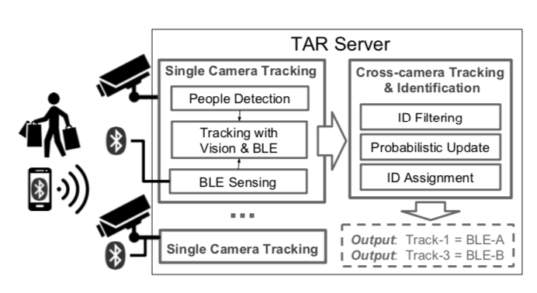
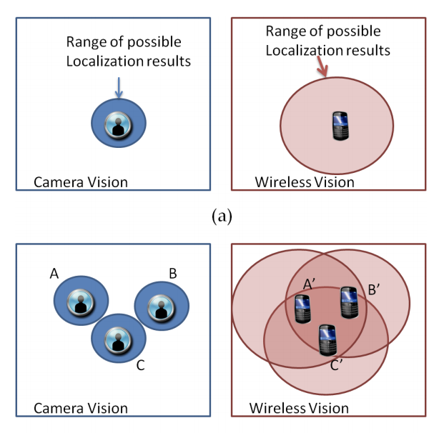
Motivation
New opportunity: fusing Vision and Radio
Surveillance cameras are pervasively deployed in public areas
High accuracy localization and tracking
Low start-up efforts
PHADE Ubicomp’18
TAR Mobisys’18
EV-loc TMC’15
Notes:
[START]Nowadays, surveillance cameras are pervasively deployed in public areas, such as shopping malls, museums, galleries and so on.
Researchers realize that these widely installed surveillance cameras could provide advantages to radio and IMU-based localization in terms of both accuracy and start-up efforts

Slide 4
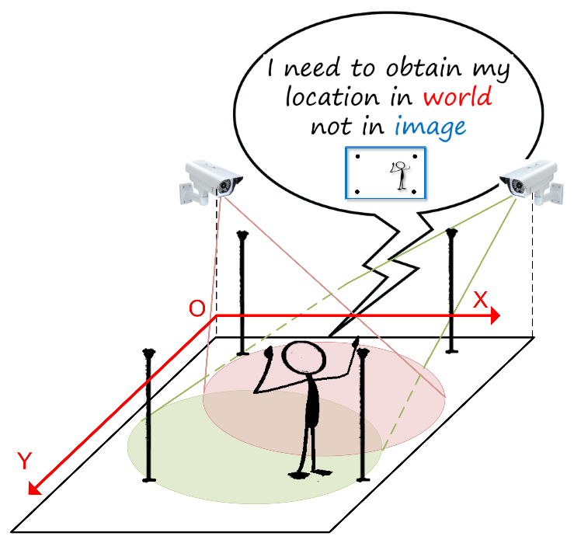
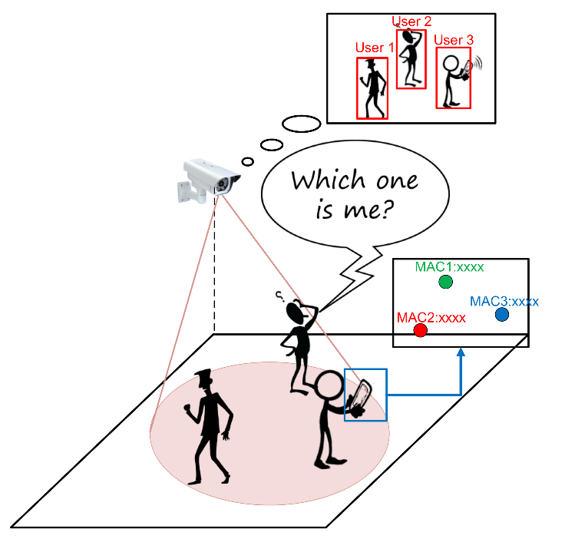
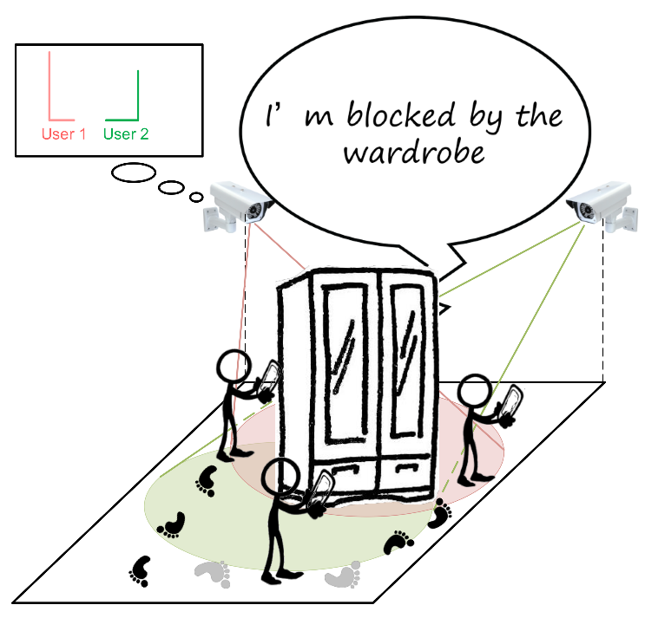
Motivation
Simply fusing Vision and Radio is not a guarantee for high accuracy and zero human effort
Absence of absolute location
Incorrespondence of identification
Looseness of sensor fusion
Notes:
[START]However, there are still three challenges need to be solved.
[CLICK] First, absence of absolute location, vision-based tracking systems are capable of bounding pedestrians in images, however, they cannot obtain absolute locations of pedestrians in world-coordinate.
[CLICK] Second, the user ID provided by vision-based approaches cannot be directly associated with the user ID provided by radio systems (typically device ID, mac address)
[CLICK]Finally, because of the frequent LOS blockages, the trace generated by vision based systems are not always smooth and continuous. Therefore, as many existing works, fusing at trace-level may degrade in complicated circumstances, leaving room for improvement.

Slide 5



Motivation
Simply fusing Vision and Radio is not a guarantee for high accuracy and zero human effort
iVR =
Automatic
map construction
+
Tightly coupled sensor fusion method
Absence
of absolute location
Incorrespondence
of identification
Looseness
of sensor fusion
Notes:
[START]To tackle the above challenges,
[CLICK]we design iVR, a tightly integrated vision and radio localization system that achieves sub-meter accuracy with zero human effort.
[CLICK]To obtain the absolute location, we propose an automatic map construction algorithm to construct indoor maps and calculate a projection matrix associating pixel in image with location on floor-plan.
[CLICK] To associate user identifications and tightly couple different source of datas, we devise an augmented particle filter to fuse the intermediate results reported by independent systems
In the following, I’ll introduce these two parts.

Slide 6
System Overview
Notes:
[START] This is an overview of our system
[CLICK] During the initialization phase, iVR uses video data recorded from cameras to construct an indoor semantic map.
During the localization phase, iVR takes as input the three types of data including
[CLICK] detection result with vision,
[CLICK] indoor localization result with wireless and
[CLICK] PDR result with IMU
[CLICK] Finally, iVR adopts an Augmented Particle Filter to fuse these intermediate, obtain accurate location and trajectory of each individual pedestrian.

Slide 7
Automatic Map Construction
Overview
Input: Images captured from a couple of ambient surveillance cameras
Output: Indoor map(floorplan) and Projection matrix
Key algorithm: Binocular Stereo Vision + SfM Calibration
Unparallel
Notes:
Automatically constructing indoor map is an essential part to enable vision-based indoor localization with zero human effort.
In our system, the input is merely a pair of images captured from two surveillance cameras.
The key idea is leveraging binocular stereo vision algorithm
Seem two cameras as two eyes in human vision system,
[CLICK] But standard BSV requires two cameras with parallel optical axes, which cannot be fulfilled by any pair of deployed surveillance cameras in practice.
To solve this problem, we design SfM Calibration algorithm to first generate a virtual image.
[CLICK] The image can be seem as captured by a camera with parallel optical axes

Slide 8
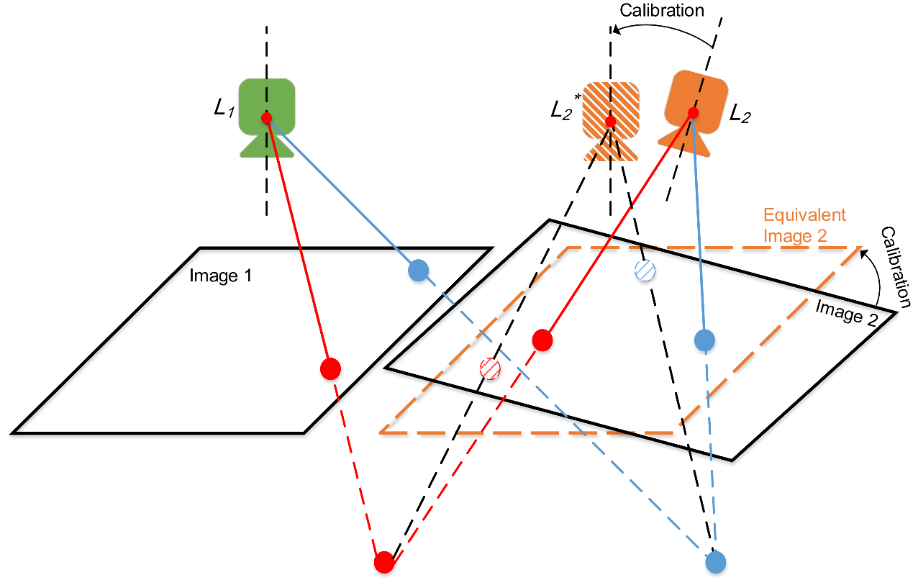
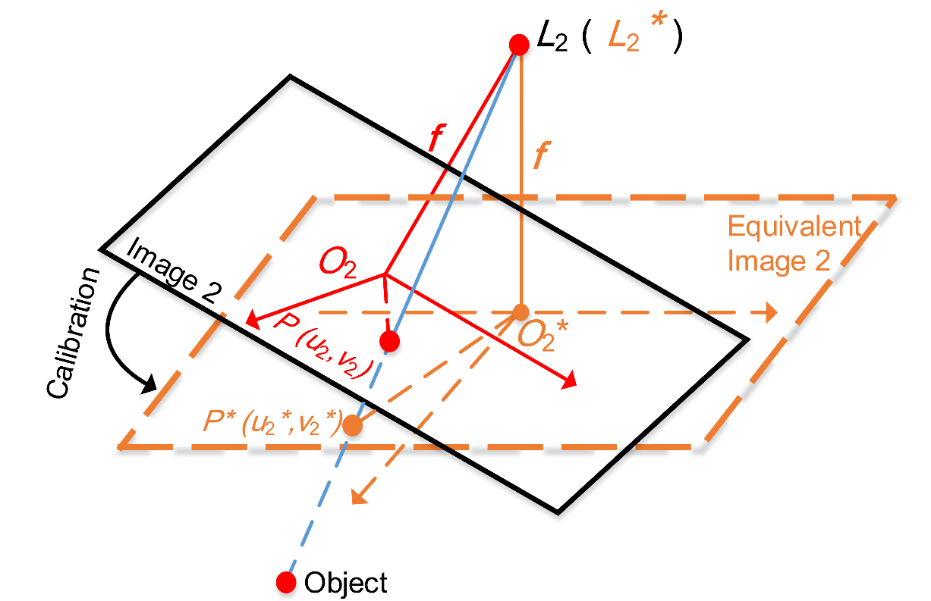
Automatic Map Construction
SfM Calibration
Relative Pose Calculation by SfM
Equivalent Virtual Image Generation
Notes:
We first match the feature points extracted from two images and then calculate the relative pose of the two cameras by leveraging Structure from motion algorithm.
Finally according to the relative pose, we virtually rotate a camera and generate an equivalent image.
As shown in figure, green Image 1 and the orange equivalent Image 2 can be seem as captured by surveillance cameras with parallel optical axes.

Slide 9
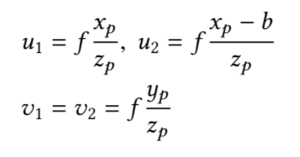
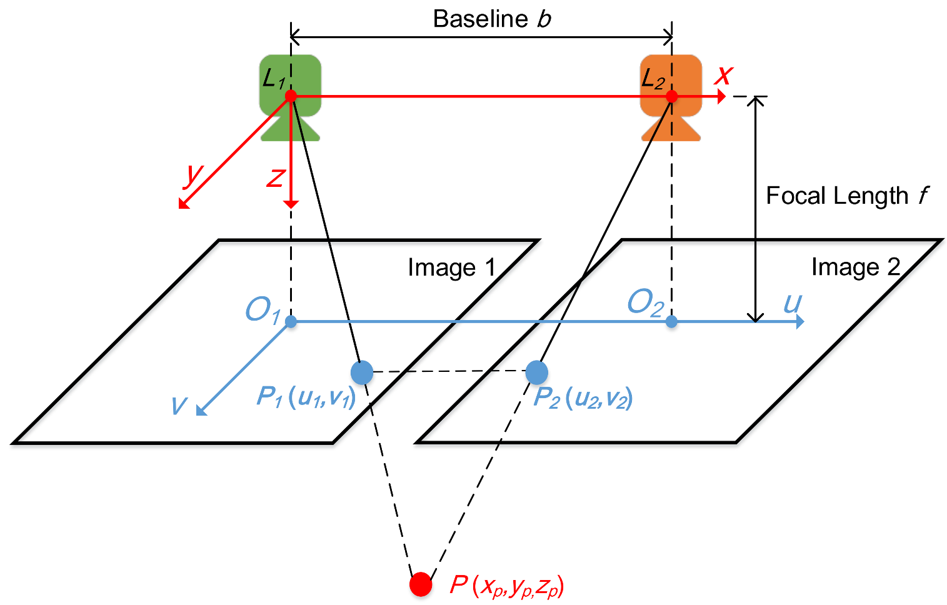
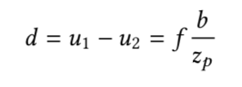
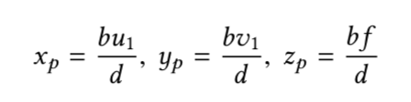
Automatic Map Construction
Binocular Stereo Vision
Location:
Notes:
Furthermore, BSV can be used to calculate the 3D location of each matched feature points.

Slide 10
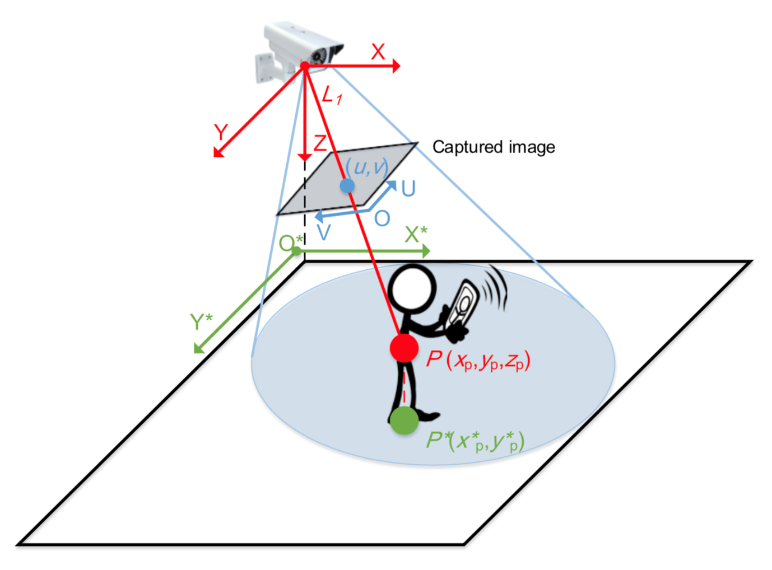
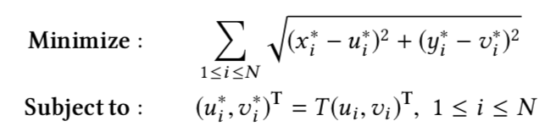
Automatic Map Construction
Map Construction and Projection Matrix Calculation
Projection Matrix (T)
Map construction
Outlining clusters of projections of
feature points using Indoor Geometric
Reasoning (IGR) algorithm
Location in world-coordinate
Location in image-coordinate
Notes:
The projection matrix can be calculated by solving an optimization problem.
[CLICK]A projection matrix associates pixels in images with locations on floor-plans
Finally, by leveraging IGR algorithm, we can outline cluster of projections of feature points and get the indoor map.

Slide 11
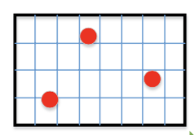
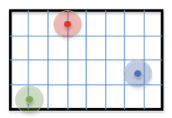

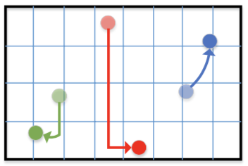
Tightly-coupled Multimodal Fusion
Augmented Particle Filter
Input
Detection with Vision
Localization with Wireless signal
Pedestrian dead-reckoning with IMU
Output
Localization and tracking result for different pedestrian at fine-grained.
Vision Modal input
Wireless Modal input
IMU Modal input
System
output
Notes:
[START] To realize tightly-coupled multimodal fusion, we design an augmented particle filter
[CLICK] The input of the particle filter contains the result of each three sub-modal
Vision modal detect pedestrians in the image and using the projection matrix to locate them on indoor floorplan, the location is relative accurate but lack of identification.
Wireless modal locate pedestrians in global-coordinate, it can provide user identification but the accuracy is coarse-grained.
IMU modal will track pedestrians but lack of global location.
[CLICK] Our particle filter fuse these intermediate result at an early stage, taking advantage of each of them and overcome the drawbacks of sub-modals. Finally, output the localization and tracking result for different pedestrian at fine-grained.

Slide 12
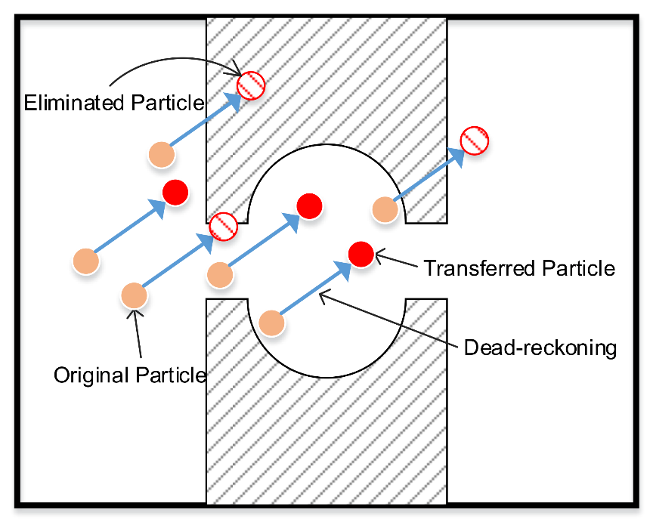
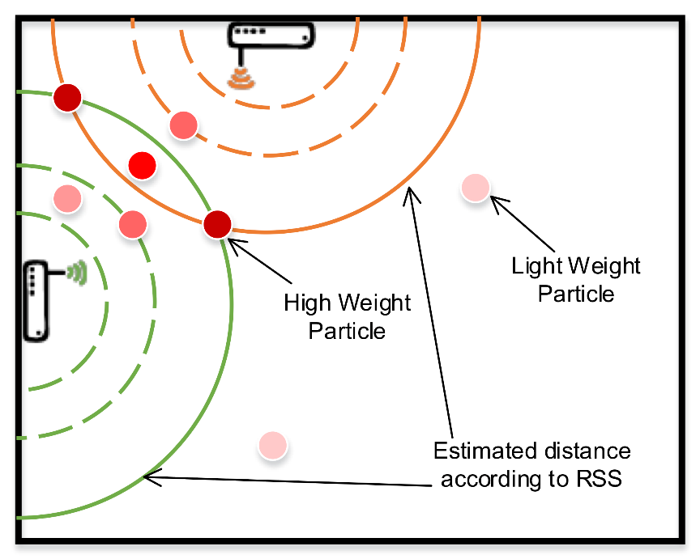
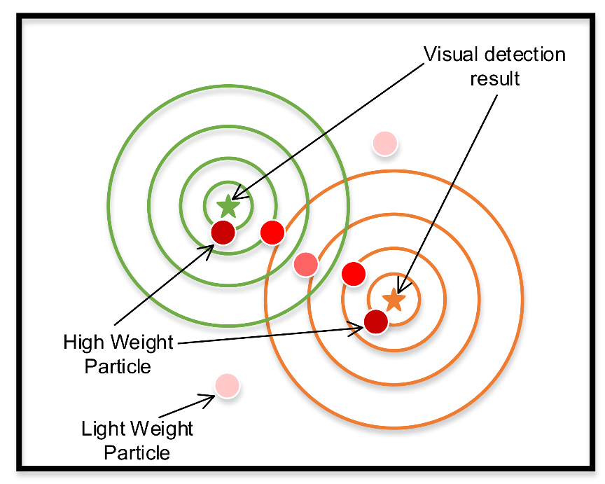
Tightly-coupled Multimodal Fusion
Augmented Particle Filter
Particle movement indicated by IMU
Particle weight assignment by wireless
Particle weight assignment by vision
Notes:
[START] In particle filter, the particle movement is indicated by IMU and leverage the pre-constructed indoor semantic map.
The particle whose trajectory cross the obstacles will be eliminated.
[CLICK] The weight assignment is indicated by wireless and vision sub-modal. The particle whose estimated distance near to physical distance will enjoy higher weight.

Slide 13
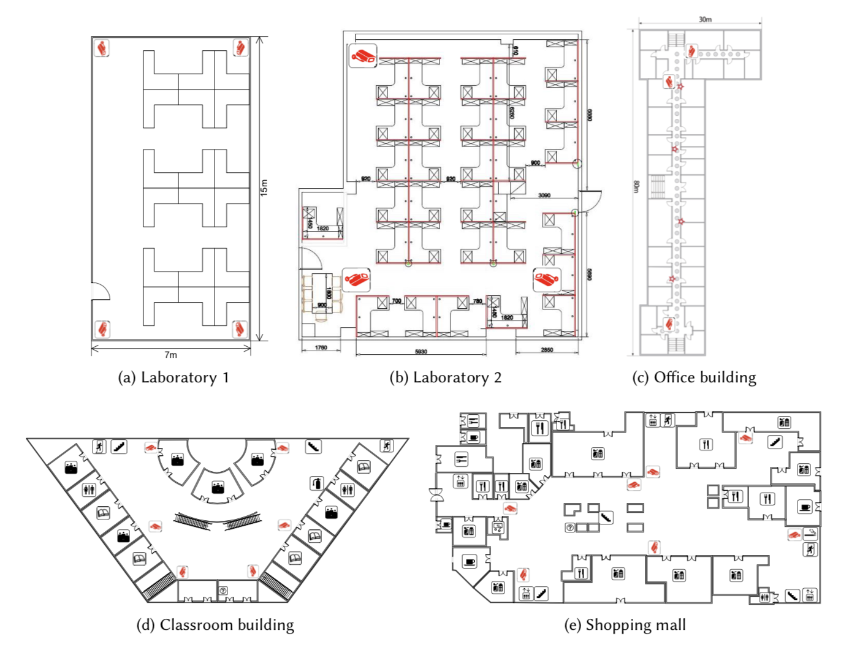
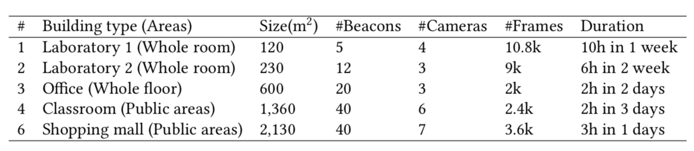
Experiment
Experimental Scenarios
Dataset & groundtruth:
https://github.com/xujingao13/iVR
Notes:
[START]We prototype iVR on 5 different smartphones and conduct experiments in 5 different building
[CLICK]the data collection details are summarized in the Table.
The dataset include more then 40k video frames and records, I and my three colleages watch these video frames and manually labeled the groundtruth, the dataset is available using the hyperlink.

Slide 14
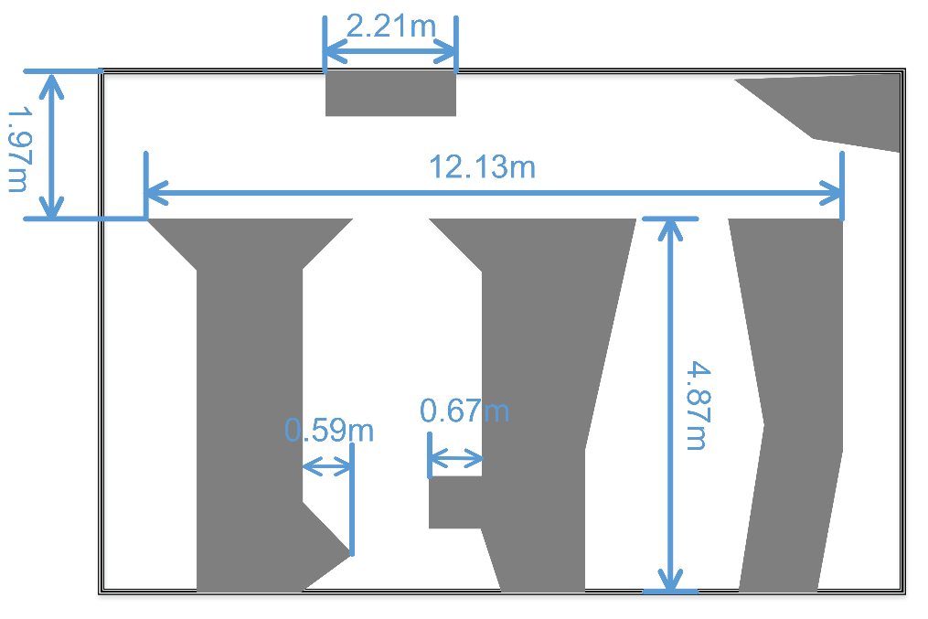
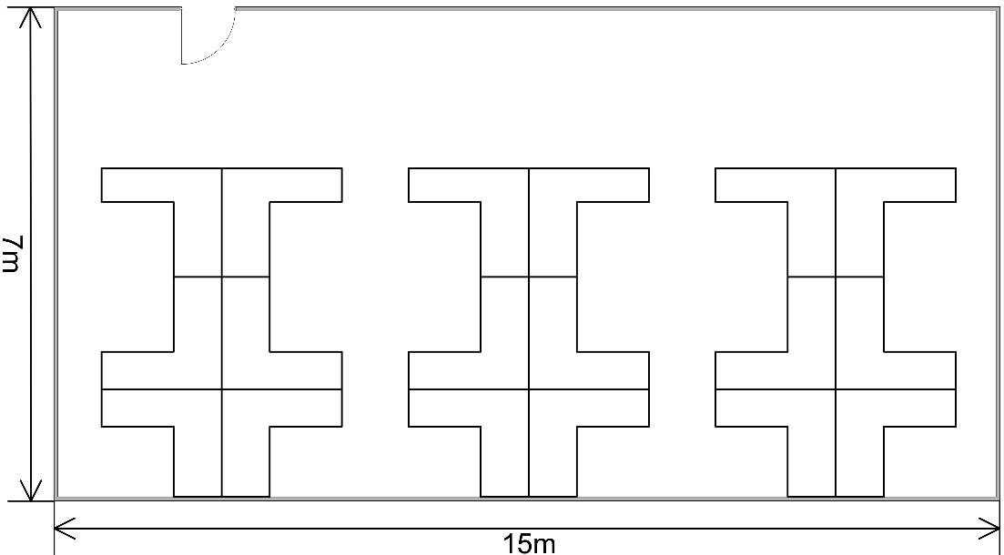
Experiment
Performance of Automatic Map Construction
iVR also displays obstacles in environment, which will promote the rationality of localization results
Automatically constructed map by iVR
Floorplan provided by Administrator
Notes:
[START] Let us first get a glimpse of the result of the floorplan automically construct by iVR.
The total length and width of the constructed map are similar to the actual floorplan.
Moreover, an automatically constructed semantic map also displays obstacles in the real environment, which is a richer source of information than simply floorplan., which will promote the rationality of localization results.

Slide 15
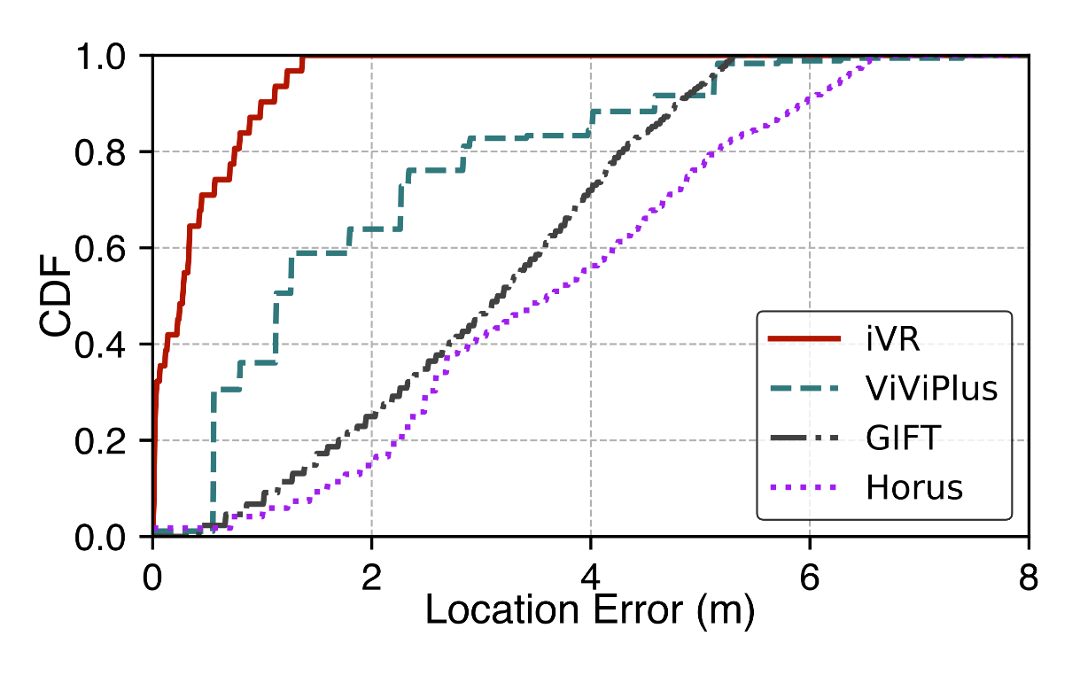
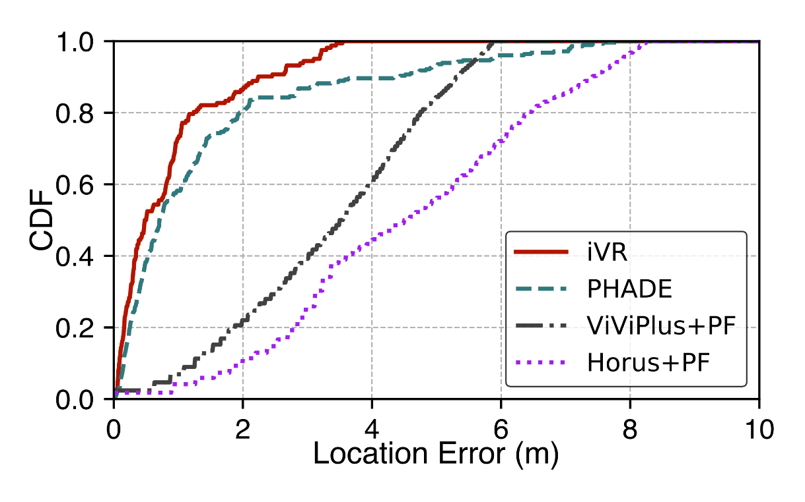
Experiment
Overall performance
Average:0.65m
95th: 1.23m
Average:0.75m
95th: 1.86m
Localization accuracy compared with state-of-the-art methods
Tracking accuracy compared with state-of-the-art methods
Notes:
[START]As shown, iVR achieves the best performance among all comparative systems in both localization and tracking task.
The average localization and tracking bias are within 1m in our scenarios.

Slide 16
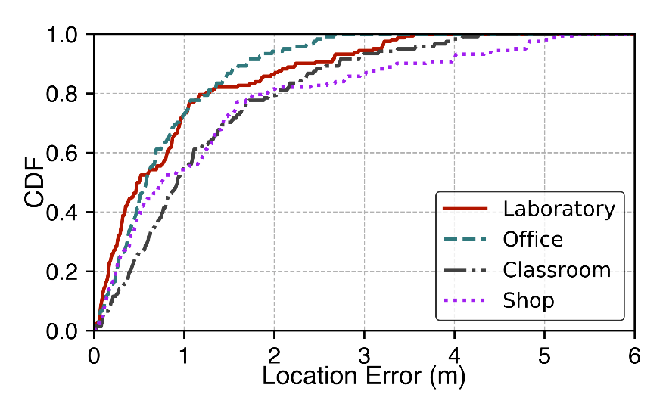
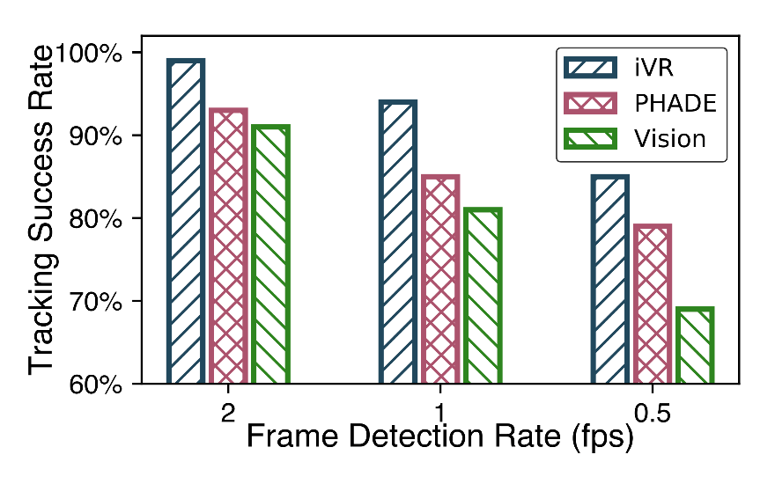
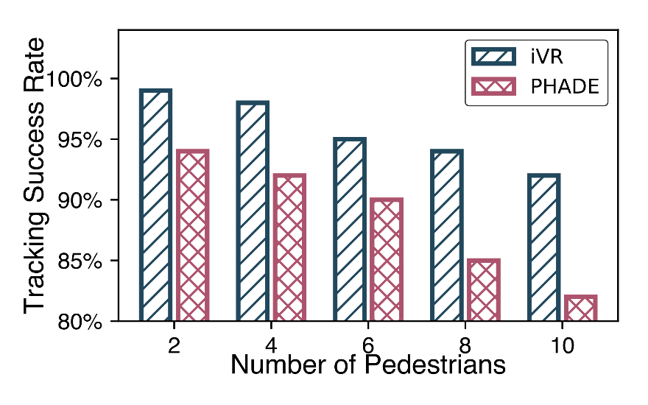
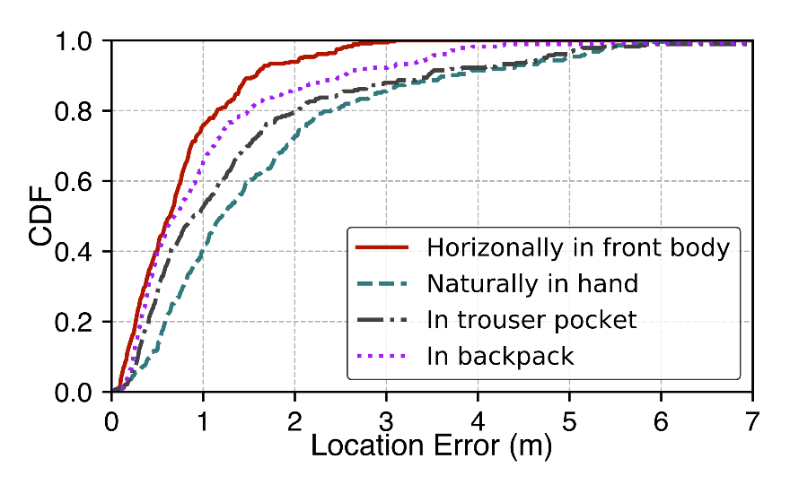
Experiment
Performance under different conditions
Different
environment
Different
frame rate
Different
Pedestrians
Different
device placements
Notes:
We also evaluate iVR under different conditions.
Including different environment, frame rate, number of users and device placements.
All the result demonstrated the robustness of iVR

Slide 17

Demo Video

Slide 18
Contribution
We design an automatic indoor semantic map construction method based on merely a couple of ambient stationary cameras.
We propose a novel augmented particle filter algorithm that tightly couples measurements from multiple orthogonal systems, including vision, radio, and IMU, and jointly estimates a target’s location with enhanced accuracy and individual label
We prototype iVR and conduct extensive experiments in 5 scenarios. The result shows that iVR outperforms existing state-of-the-art systems by 70%.
The dataset (contains > 60k video frames and labeled ground truth) can be found at https://github.com/xujingao13/iVR
Notes:
We design a method to automatically construct indoor map merely using a couple of surveillance cameras and get the absolute location for each pixel in the image.
We design an augmented particle filter to fuse vision, radio and IMU in. tightly coupled manner

Slide 19
Thanks!
Q&A
Jingao Xu
Tsinghua University
xujingao13@gmail.com

Slide 20
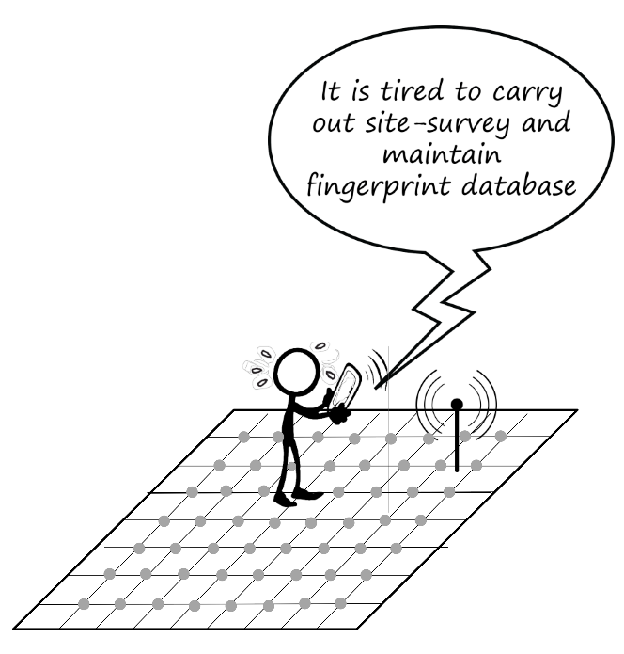
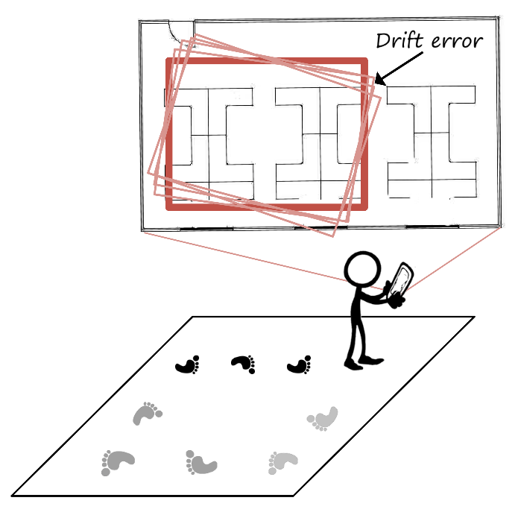
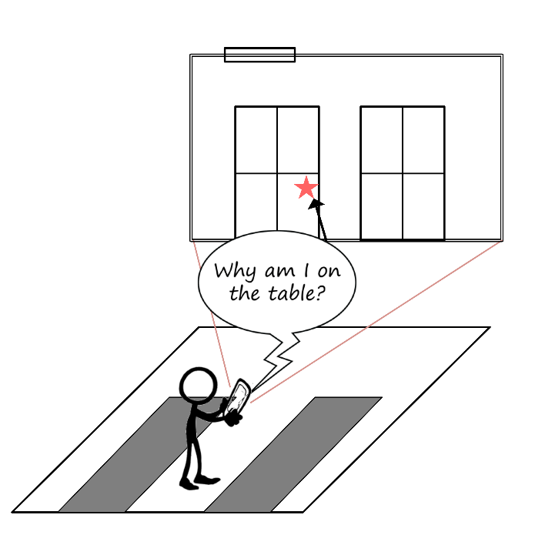
Motivation
Major Problems
Labor intensive site-survey of Wi-Fi localization methods
Drift error for IMU based tracking algorithms (PDR)
Rationality of localization results
Site-survey
Drift error
Location rationality
Notes:
[START] However, these approaches suffer from both large location errors and considerable deployment costs.
[CLICK] First, wifi fingerprint based localization system need a labor intensive site-survey, even worse, the time-consuming procedure need to be repeated overtime due to the environmental dynamics
[CLICK] It is well-known that PDR has intrinsically（因寸死扣） accumulative errors.
[CLICK] Finally, as shown in figure, indoor semantic maps are desirable to ensure the rationality of the localization results (e.g. , pedestrians should not be located on a table).
Unlike outdoor localization scenarios where we can obtain road map from Google Map, in indoor scenarios, the availability and quality of indoor floor-plans cannot always be guaranteed.

Slide 21
Conclusion
Automatic indoor map construction
Only need a couple of cameras
Present semantic information
To the best of our knowledge, this is the first work that constructs a physical map by using stationary surveillance cameras with unparalleled optical axes.
Tightly coupled sensor fusion method
Multimodal localization and tracking
Tightly coupled multimodal fusion
Augmented particle filter

